Slide 1
Cryptography
Tasneem Mirza

Slide 2
Cryptography
Cryptography : (Greek word)- Secret writing
The science and art of transforming messages to make them secure and immune to attacks
Components involved in cryptography :
Key Key
Plaintext :Original message before being transformed.
Ciphertext : Message after transformation.
Encryption : Process of transforming the plaintext into ciphertext.
Decryption : Process of transforming the ciphertext back into
plain text.
plaintext
ciphertext
plaintext
Encryption
Decryption

Slide 3
Cryptography
Cipher – Encryption and Decryption algorithms.
Key – A number or a set of numbers that the cipher (algorithm) operates on.
For the process of encryption
Input – Encryption algorithm, plaintext, key.
Output –Cipher text
For the process of decryption
Input – Decryption algorithm, ciphertext, key.
Output –Plain text
Notations used to describe the transformations :
C=E(P) C-ciphertext, P-plaintext, E-encryption algorithm
P=D(C) or
P=D(E(P)) D- Decryption algorithm.

Slide 4



Notations used in Security world
Bob, Alice want to communicate “securely”
Trudy (intruder) may intercept, delete, add messages
Alice
Bob
channel
data, control messages
secure
sender
secure
sender
secure
receiver
data
secure
receiver
data
Trudy

Slide 5
Common Terms
Cryptography
Means hidden writing, the practice of using encryption to conceal text
Cryptanalysis
Study of encryption and encrypted message, with the goal of finding the hidden meaning of the messages.
Both the cryptographer and the cryptanalyst attempt to translate the coded material back to it’s original form. But a cryptographer works on behalf of a legitimate sender or receiver, whereas a cryptanalyst works on behalf of an unauthorized interceptor.

Slide 6
Cryptography
Cryptographic algorithms
Symmetric key –
Same key is used for encryption and decryption.
Hence the key is called the shared secret key.
Symmetric key
(Shared secret key)
Asymmetric key
(Public key)

Slide 7
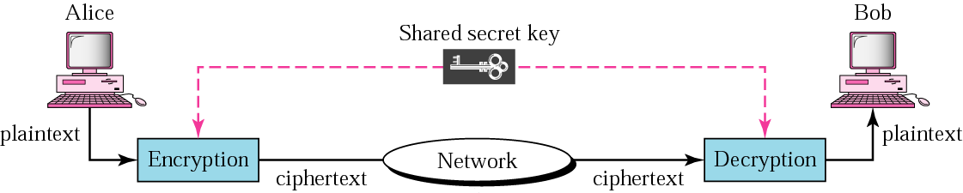
Symmetric Key encryption

Slide 8
Asymmetric Key encryption
Drawbacks of symmetric key :
Key must remain secret at both ends
In large networks, there are many keys pairs to be managed
Sound cryptographic practices dictates that the key be changed frequently
The shared secret key must be transmitted through an insecure transmission channel.
Asymmetric key encryption
Uses 2 keys public and private key
Public Key- known to all
Private key – known only to the receiver.

Slide 9
Asymmetric Key encryption
Every communicating entity creates 2 keys public and private.
Every communicating entity distributes it’s public key to every other entity and keeps it’s private key to itself.
If Alice wants to send a message to Bob, Alice encrypts the message with Bob’s public key and when Bob receives the message, it decrypts it with its own private key.

Slide 10
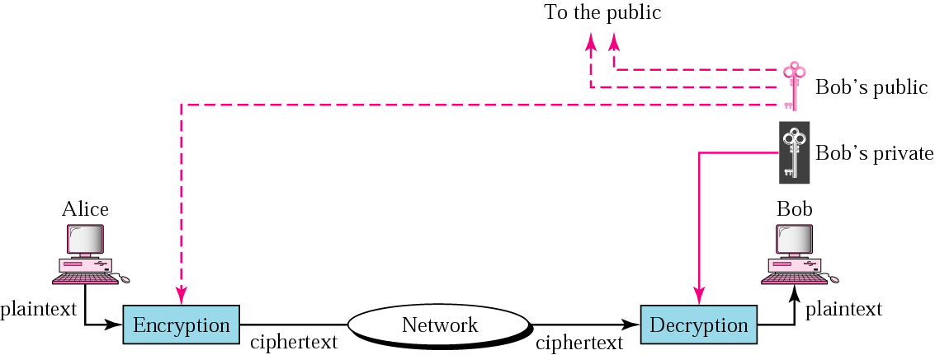
Asymmetric Key encryption

Slide 11
Two types of symmetric ciphers
Stream ciphers
Encrypts one bit/character at a time
Block ciphers
Break plaintext message in equal-size blocks
Encrypts each block as a unit

Slide 12
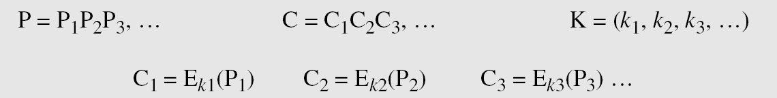
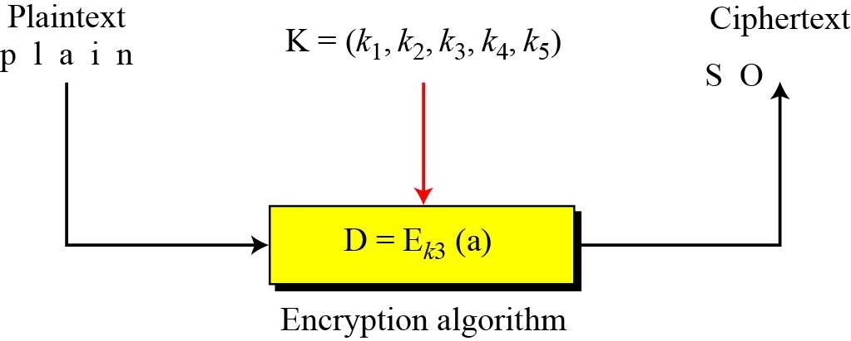
Stream and Block Ciphers
Stream cipher
Converts one symbol of plaintext into a symbol of ciphertext.
i.e Encrypts data symbol by symbol
Call the plaintext stream P, the ciphertext stream C, and the key stream K.

Slide 13
Stream and Block Ciphers
Keystream may be a stream of predetermined values or
May be created by an algorithm or can be a single value.
Note : Monoalphabetic cipher
k={k,k,k…….}

Slide 14
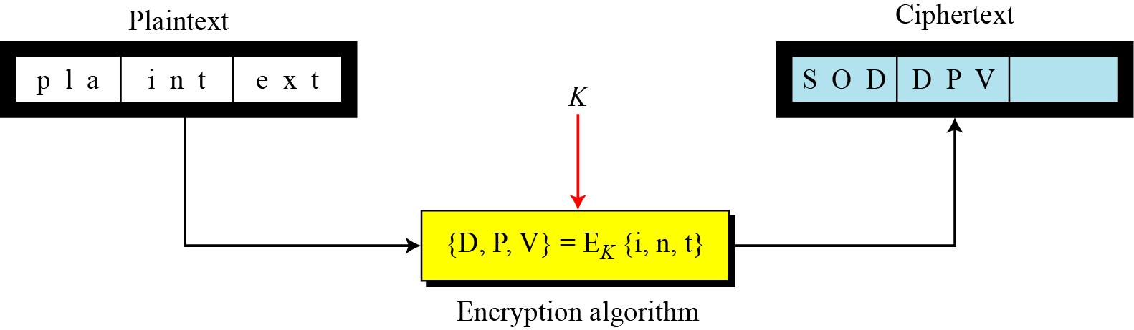
Stream and Block Ciphers
Block Cipher:
Encrypts a group of plaintext symbols to produce a group of
ciphertext symbols of the same size.
A single key is used to encrypt the block even if the key is made
up of multiple values.

Slide 15
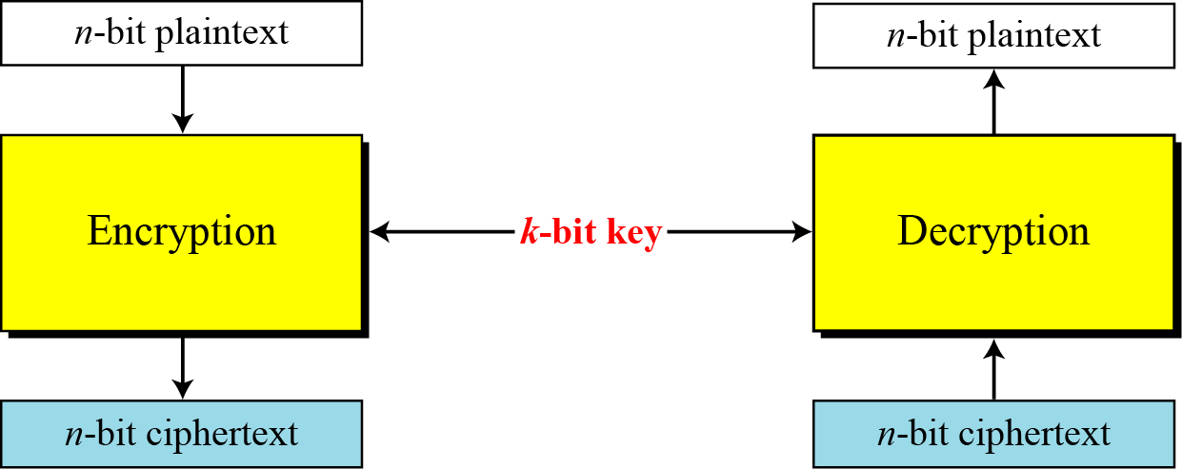
Block Cipher
With the advent of computer –What we need is bit oriented protocols.
Since information to be encrypted is not just text but can be numbers, graphics, audio and video data.

Slide 16
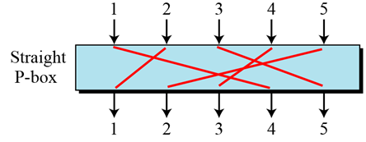
Components used by a modern block cipher
Components used by a modern block cipher :
1. D-box /P- box(diffusion box/permutation box)
Parallels the transposition cipher for characters.
It transposes bits.
3 types of D-boxes :
a) Straight D-box
Box with m inputs and n outputs where m=n

Slide 17
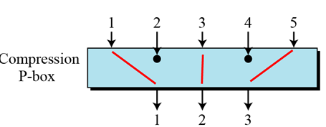
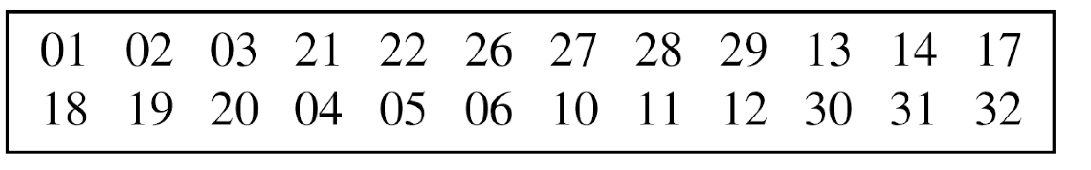
Components used by a modern block cipher
b) Compression D-box
Box with m inputs and n outputs where m>n.
Some of the inputs are blocked and do not reach the output.
Eg : 32 x 24 Compression D- box

Slide 18
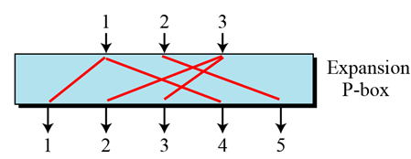
Components used by a modern block cipher
c) Expansion D-box
A box with m inputs and n outputs where m<n
Eg :12 x 16 Expansion D-box

Slide 19
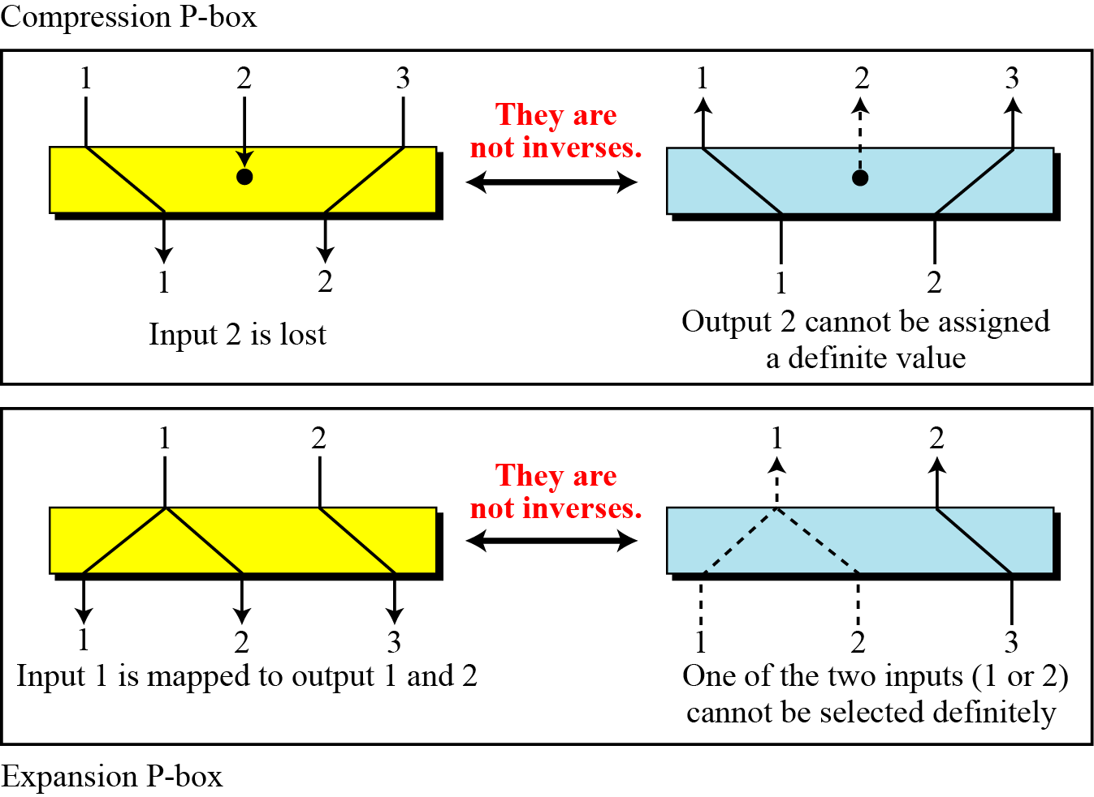
Components used by a modern block cipher

Slide 20
Components used by a modern block cipher
2. Substitution box (S-box)
Input to an S box is a stream of bits with length N, the result is another stream of bits with length M.
M and N need not be the same.
Used in the intermediate stage in the process of encryption and decryption.
The function that matches input to the output is defined by a table.

Slide 21
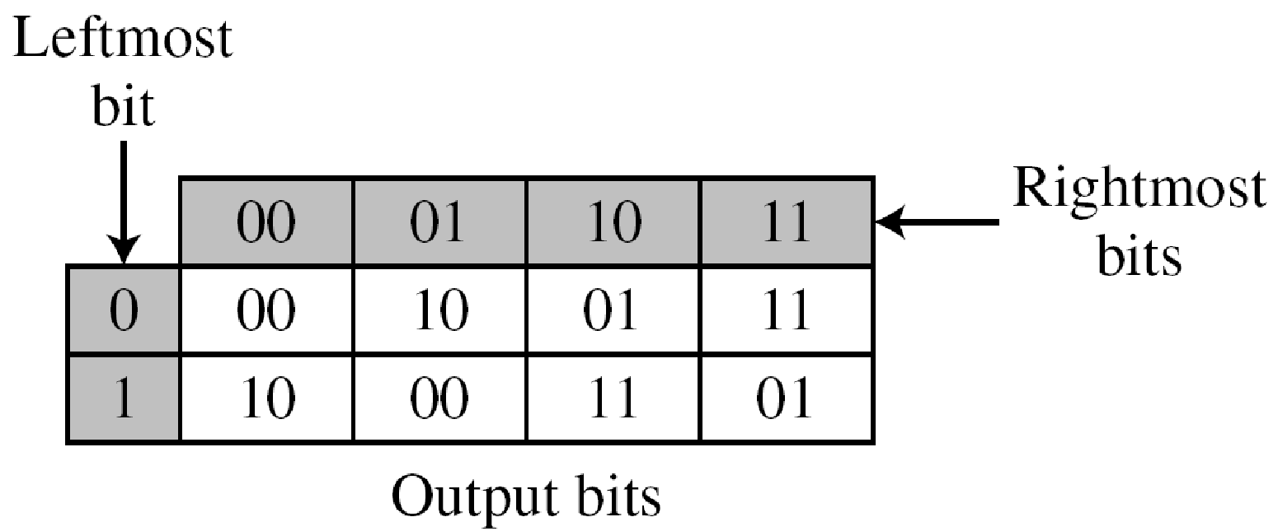
Components used by a modern block cipher
Eg :of a 3 x 2 S-box
Based on the table, an input of 010 yields the output 01
An input of 101 yields the output of 00.

Slide 22
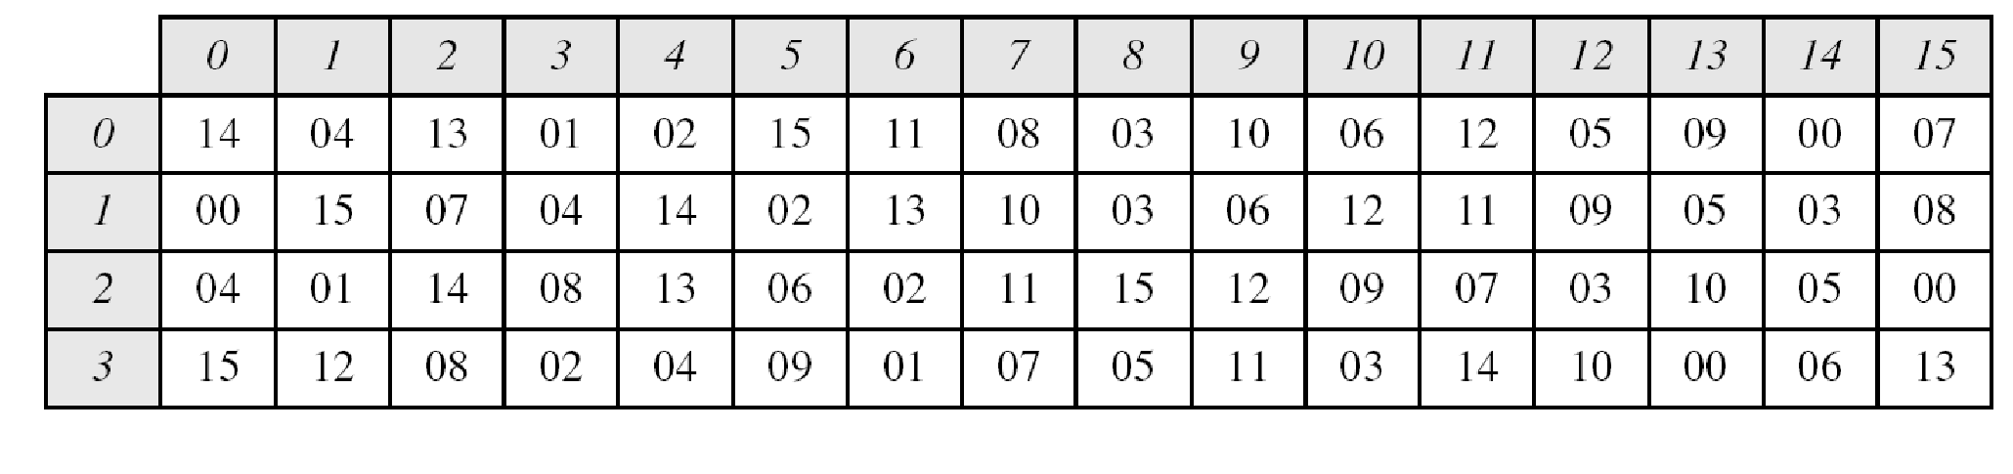
Components used by a modern block cipher
Eg 6 x 4 S-box
First an the last bits select the row. Middle 4 select the column
The input to S-box 8 is 000000. What is the output?
O/p- 1110
The input to S-box 1 is 100011. What is the output?
O/p- 1100

Slide 23
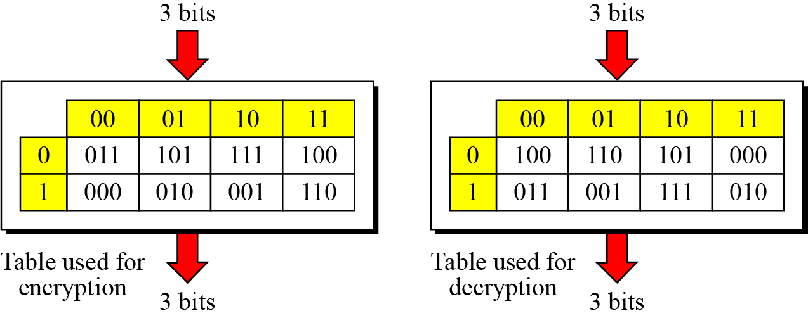
Components used by a modern block cipher
An S-box may or may not be invertible. In an invertible S-box, the number of input bits should be the same as the number of output bits.
For example, if the input to the left box is 001, the output is 101. The input 101 in the right table creates the output 001, which shows that the two tables are inverses of each other.

Slide 24

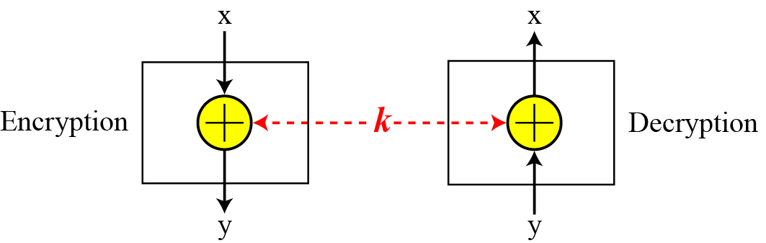
3. XOR
An important component in most block ciphers is the
exclusive-or operation.

Slide 25
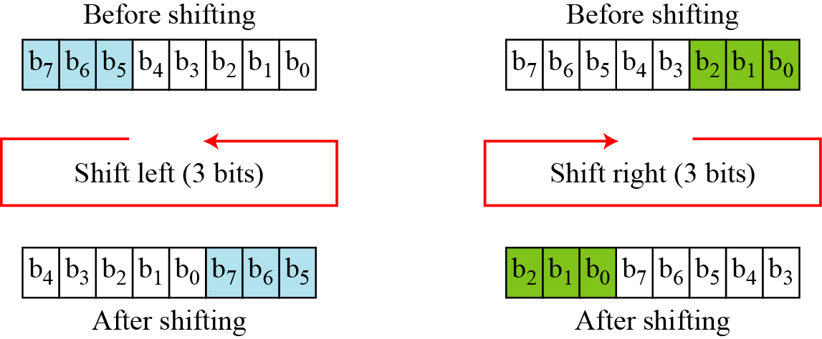
4. Rotation
Another component found in some modern block ciphers is the
circular shift operation.

Slide 26
Properties of a good cipher
1. Diffusion
Hides the relationship between the ciphertext and the plaintext.
This will frustrate the interceptor who uses the ciphertext to
find the plain text.
It implies that each symbol (char/bit) in the ciphertext is dependent on some or all symbols in the plaintext.
OR
If a symbol in the plaintext is changed several or all symbols in the ciphertext will also be changed.
In a cipher with good diffusion , o/p should depend on the input symbols in a very complex way.

Slide 27
Properties of a good cipher
2. Confusion
Hides the relationship between the ciphertext and the key.
This will frustrate the interceptor who tries to use the ciphertext to find the key.
If a single bit in the key is changed most or all bits in the ciphertext will also change.

Slide 28
Modern block ciphers
Product Ciphers
A product cipher is a complex cipher combining substitution, permutation and other simple ciphers.
Iterated product ciphers are used to achieve diffusion and confusion.
Each iteration is referred to as a round.
A key generator creates different keys for each round from the cipher key.
In an N round cipher, the plaintext is encrypted N times to create the ciphertext and the ciphertext is decrypted N times to create the plaintext.
Eg: 2 round product cipher

Slide 29
Product ciphers
3 transformations happen at each round :
The 8 bit text is mixed with the key to whiten the text(hide the bits using the key). i.e. EXOR 8 bit word with the 8 bit key.
The output of the whitener are organized into 2 bit groups and fed into 4 S-boxes. The values of bits are changed based on the structure of the S-box.
The outputs of S-boxes are passed to the P-box(Straight) which transposes the bits so that in the next round each box receives different input.

Slide 30
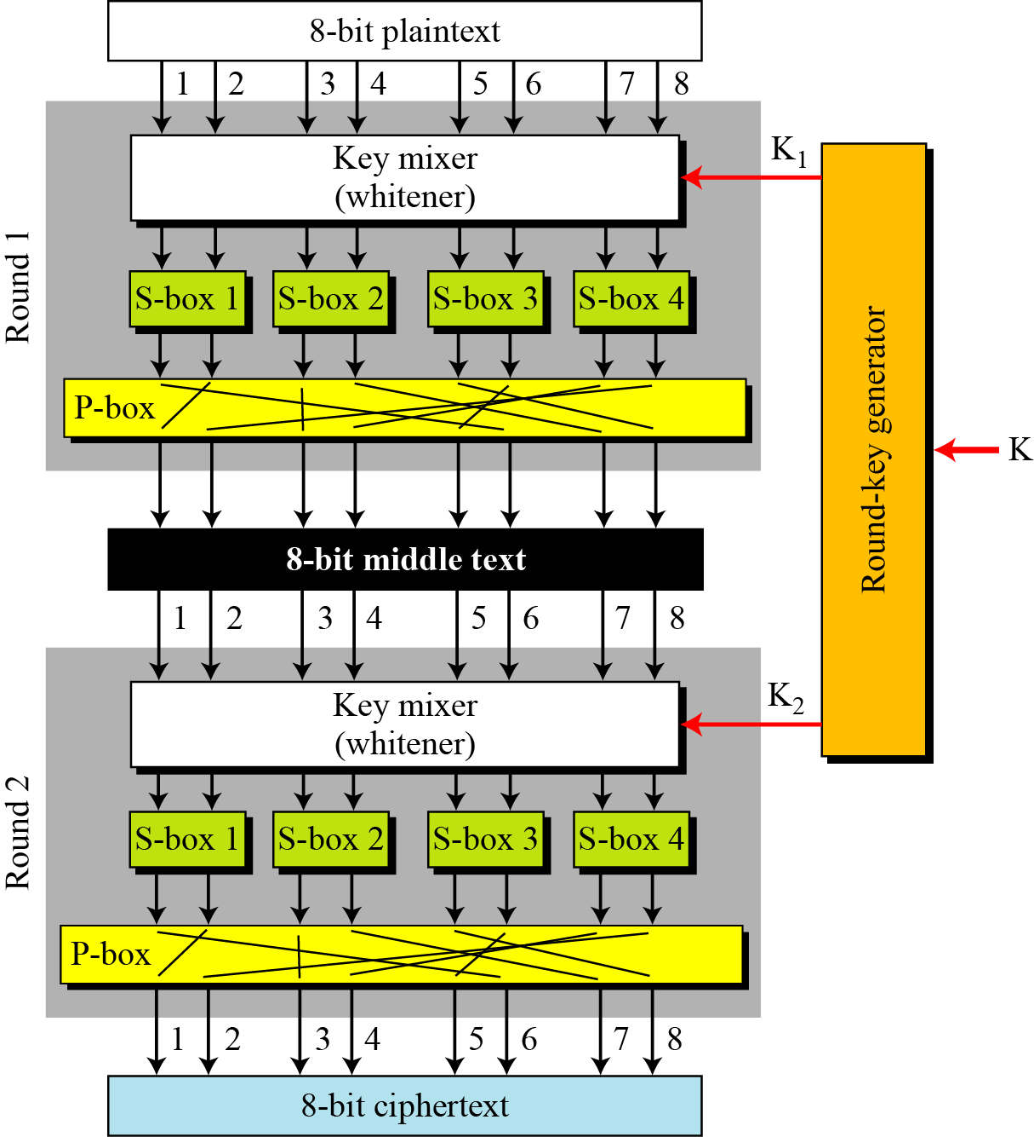
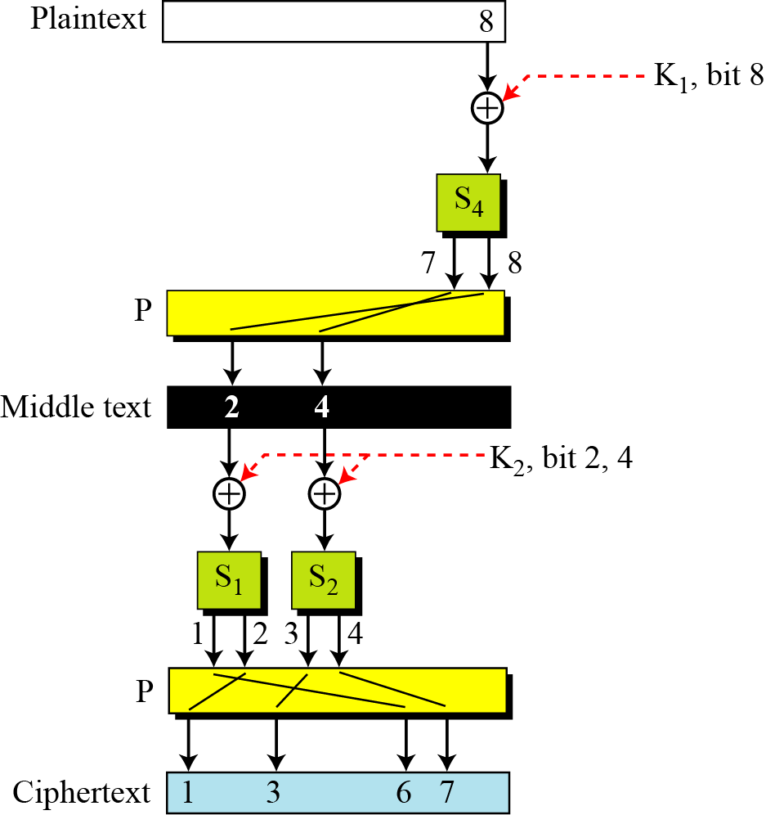

Slide 31
Product ciphers
How is diffusion achieved?
i.e. changing a single bit in the plaintext affects many bits in
the ciphertext.
1. In the first round bit 8, after being EX-ored with the corresponding bit of K1 affects 2 bits( 7 and 8) thru s-box 4. Bit 7 is permuted and becomes bit 2; bit 8 is permuted and becomes bit 4.
After the first round bit 8 has affected bits 2 and 4.
2. In the second round bit 2 after being Ex-ored with the corresponding bit in K2 affects 2 bits (bits 1 and 2) through S-box.
Bit 1 is permuted and becomes bit 6; bit 2 becomes bit 1.
Bit 4 after being Ex-ored with the corresponding bit in K2 affects bits 3 and 4. Bit 3 remains same, 4 becomes 7.
Hence after the second round bit 8 has affected bits 1,3,6,7.

Slide 32
Product ciphers
How is confusion achieved?
The 4 bits of ciphertext 1,3,6,7 are affected by 3 bits in the key
(bit 8 in K1 and bit 2 and 4 in K2)
Note : To improve confusion and diffusion practical ciphers use larger data blocks , more S boxes, and more rounds

Slide 33
Product ciphers
Modern block ciphers are all product ciphers, but they are divided into two classes.
1. Feistel ciphers :
A Feistel cipher can have three types of components: self-invertible, invertible, and noninvertible.
Eg: DES
2. Non-Feistel ciphers :
Consists of only invertible components. Eg: AES

Slide 34
Feistal ciphers
A Feistel cipher can have three types of components: self-invertible, invertible, and noninvertible.
How are encryption and decryption algos. inverse of each other if each has a non- invertible unit?
Eg of a non invertible component
Assume that the function takes the first and third bits of the
key, interprets these two bits as a decimal number, squares the
number, and interprets the result as a 4-bit binary pattern.
f(101) ---- The function extracts the first and third bits to get
11 in binary or 3 in decimal. The result of squaring is 9, which
is 1001 in binary.
f(101)= 1001
This function is non invertible.

Slide 35
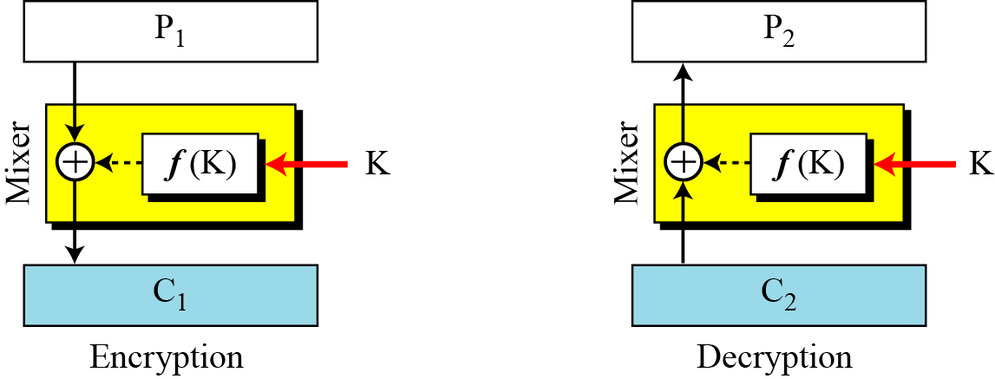
The first thought in Feistel cipher design
In encryption , a non invertible function f(k) accepts the key as the input.
The o/p of this component is Ex-ored with the plaintext to get the ciphertext.
Combination of the function and the Ex-or is called the mixer.
Key K is the same.

Slide 36
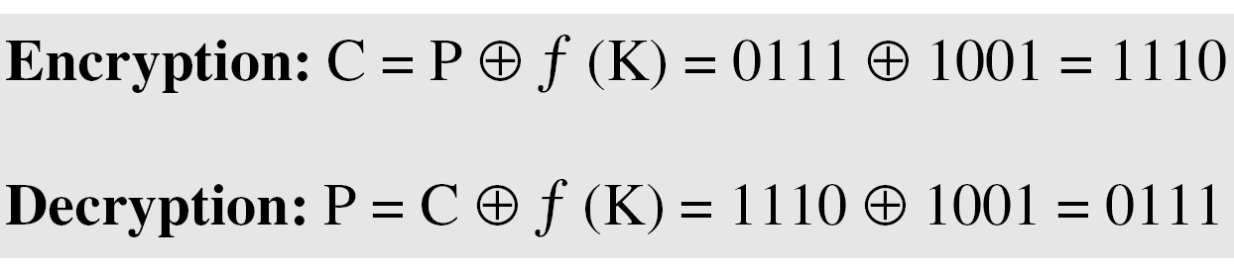
Product ciphers
The plaintext and ciphertext are each 4 bits long and the key is 3 bits long. Assume that the function takes the first and third bits of the key, interprets these two bits as a decimal number, squares the number, and interprets the result as a 4-bit binary pattern. Show the results of encryption and decryption if the original plaintext is 0111 and the key is 101.
Solution
The function extracts the first and third bits to get 11 in binary
or 3 in decimal. The result of squaring is 9, which is 1001 in
binary.

Slide 37
Product ciphers
The function f(101)=1001 is non invertible, but the Exor operation allows us to use the function in both encryption and decryption.
Function is non-invertible but the mixer is self invertible.

Slide 38
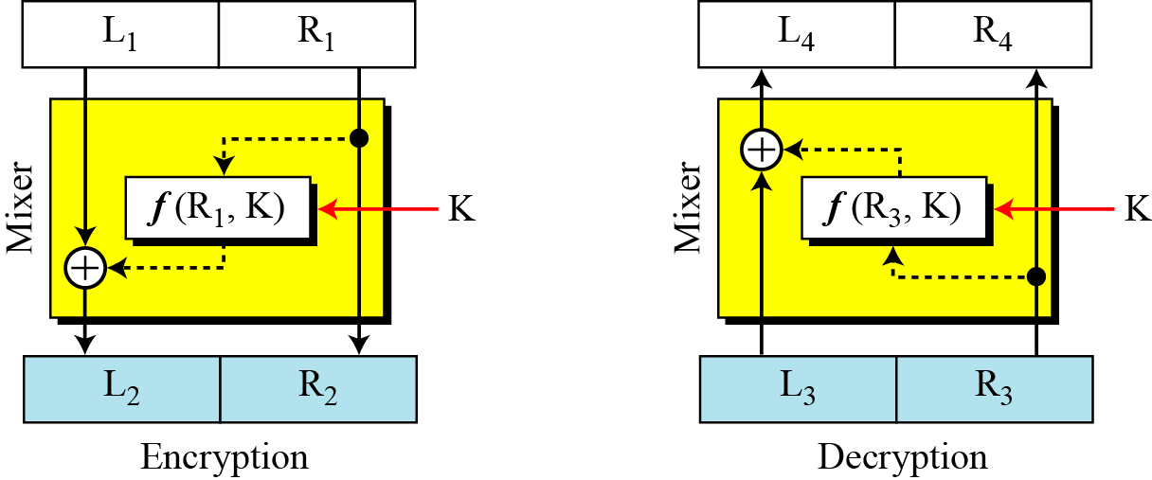
Improvement of the previous Feistel design
In the initial feistal design only the key is input to the function.
Improvement –Let part of the plaintext in the encryption and part of the ciphertext in the decryption be also the input to the function.
Key is the second input to the function.
Inputs to the funtion should be exactly the same in encrp. and decryp
Hence right side of PT in encrp and right side of CT in decry must be the same

Slide 39
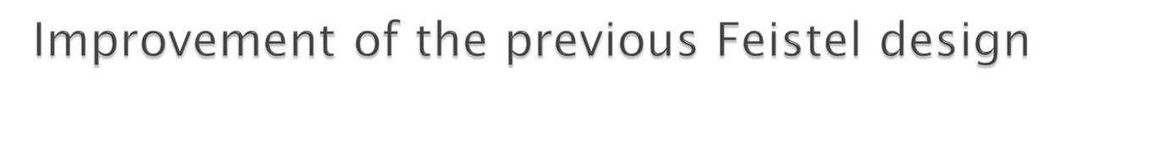
Assume L3=L2 and R3=R2(i.e no change in ciphertext during transmission)
R4=R3=R2=R1
L4=L3 ⊕ f(R3,K)
=L2 ⊕ f(R2,k)
=L1 ⊕ f(R1,k) ⊕ f(R1,k) =L1
L4=L1

Slide 40
Final Feistal cipher design
Drawback of the previous design :
The right side of the plaintext does not undergo encryption.
Improvement
Increase the no. of rounds/iterations.
Add a new element to each round , a swapper which swaps the left and right halves in each round.

Slide 41
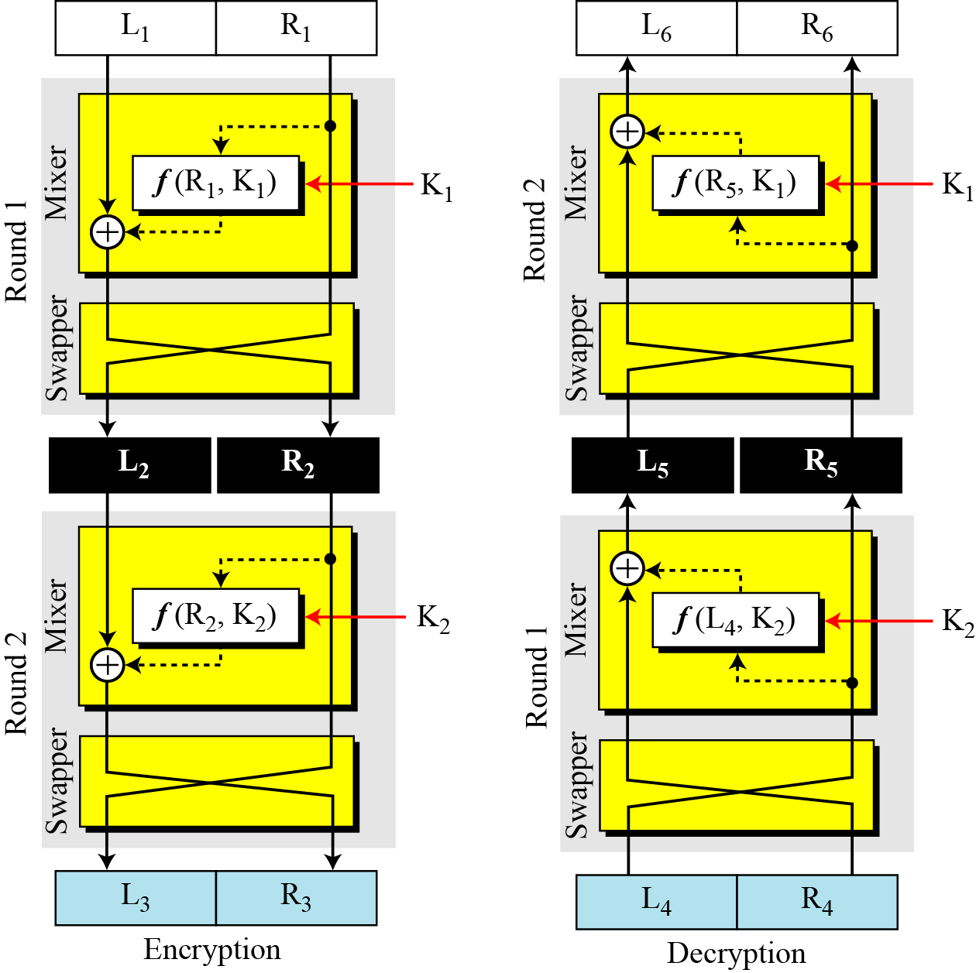
Final design of a Feistel cipher with two rounds
Note : Instead of f(R5,K1) it is f(L5,K1)

Slide 42

Prove L6=L1 and R6=R1 if L4=L3 and R4=R3
First we prove L5=L2 and R5=R2
L5=R4 ⊕ f(L4,K2)
=R3 ⊕ f(R2,K2)
L5=L2 ⊕ f(R2,K2) ⊕ f(R2,K2) = L2
R5= L4=L3=R2
L6=R5 ⊕ f(L5,K1)
=R2 ⊕ f(L2,K1)
L6=L1 ⊕ f(R1,K1) ⊕ f(R1,K1)=L1
R6=L5=L2=R1

Slide 43
Asymmetric Key Cryptography

Slide 44
Difference between symmetric and asymmetric cryptography
1. In a community of n people ->
Symmetric- Key cryptography requires n(n-1)/2 shared secret keys
Asymmetric- key cryptography requires n personal secret keys are needed
2. Symmetric Key cryptography is based on sharing secrecy.
Asymmetric- key cryptography is based on personal secrecy.
3. Symmetric – Plain text and ciphertext are
symbols(bits/characters).
Asymmetric- Plaintext and ciphertext are numbers.
4. Symmetric-Encryption and decryption is based on
permutation and substitution of symbols.
Asymmetric- Encryption and decryption are mathematical functions

Slide 45
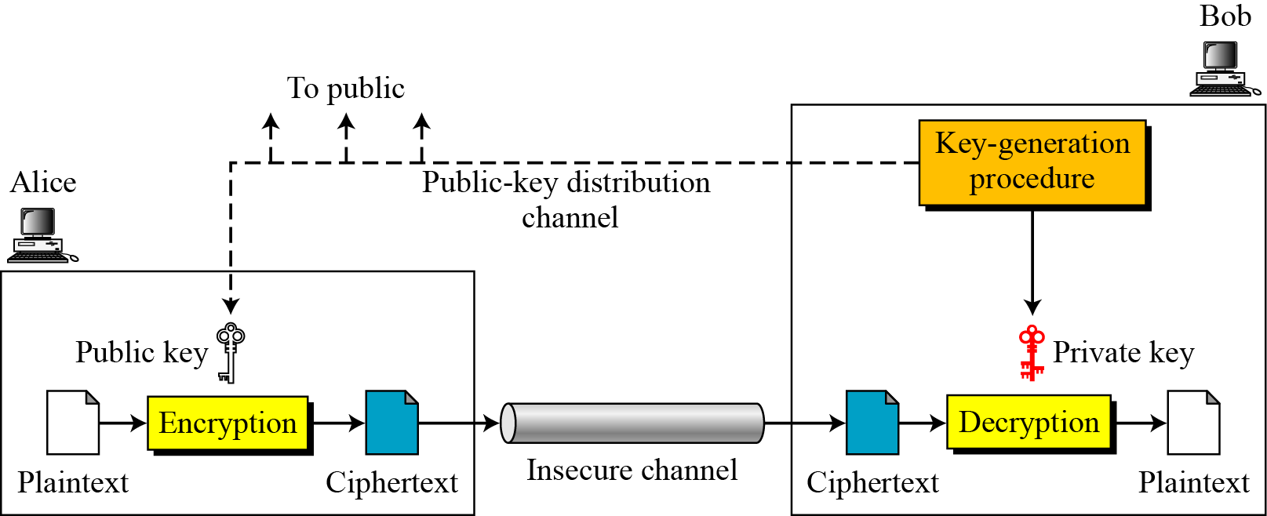
General idea of asymmetric key cryptography

Slide 46
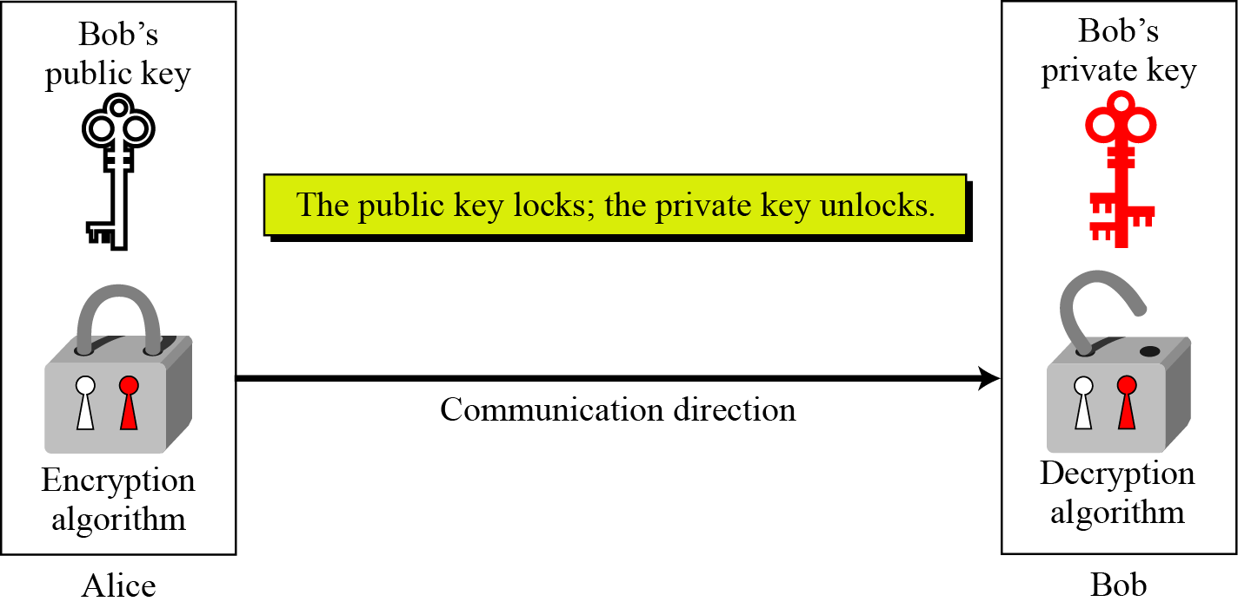
Principles of public key cryptosystems

Slide 47
Plaintext/Ciphertext
Unlike in symmetric-key cryptography, plaintext and ciphertext are treated as integers in asymmetric-key cryptography.
Encryption/Decryption
C = f (K_{public} , P) P = g(K_{private} , C)
There is a very important fact that is sometimes misunderstood: The advent of asymmetric-key cryptography does not eliminate the need for symmetric-key cryptography.

Slide 48
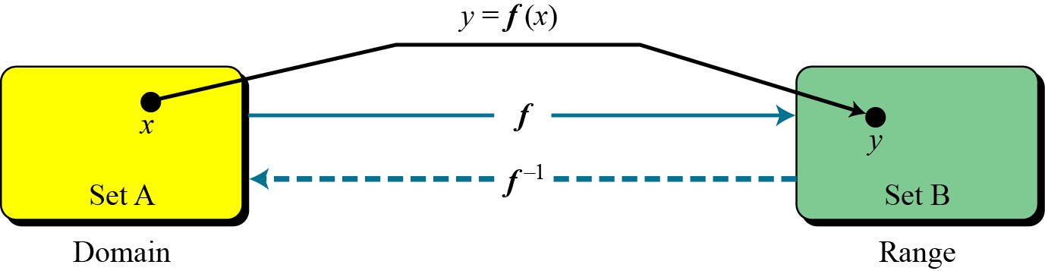
Trapdoor One way function
The main idea behind asymmetric-key cryptography is the concept of the trapdoor one-way function.
Functions

Slide 49
Trapdoor One way function
One-Way Function (OWF)
f is easy to compute.
In other words, given x, y=f(x) can be easily computed
f ⁻¹ is difficult to compute.
In other words, given y, it is computationally infeasible to calculate x= f ⁻¹(y).

Slide 50
Trapdoor One way function
A trapdoor one-way function is a one-way function with a third
property :
3. Given y and a trapdoor(secret), x can be computed easily.
Public-key cryptosystems are based on trap-door one-way
functions.
The public key gives information about the particular instance
of the function; the private key gives information about the trap
door.
Whoever knows the trap door can perform the function easily in
both directions, but anyone lacking the trap door can perform
the function only in the forward direction.
The forward direction is used for encryption and the inverse
direction is used for decryption

Slide 51
Modular multiplicative inverse
The modular multiplicative inverse of an integer a modulo m is an integer x such that
a.x mod m =1
OR
The multiplicative inverse of a in Z_{m} is x.
This no. x is between 0 to m-1.
For eg :
4 is the multiplicative inverse of 3 in Z₁₁-🡪
Since
4.3 mod 11=1

Slide 52
Modular multiplicative inverse
An integer may or may not have a multiplicative inverse.
We say that multiplicative inverse of a in Zm exists if gcd(a,m)=1.
Find the multiplicative inverse of 8 in Z₁₀.
There is no multiplicative inverse because gcd (10, 8) = 2 ≠ 1.
In other words, we cannot find any number between 0 and 9
such that when multiplied by 8 mod 10 =1.

Slide 53
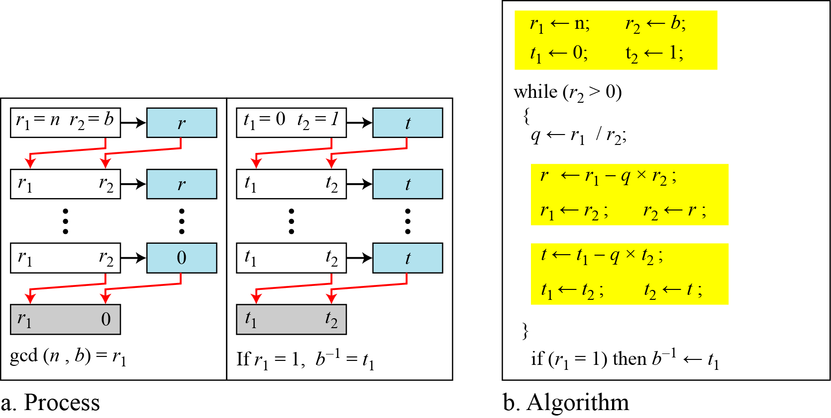
Modular multiplicative inverse
Using extended Euclidean algorithm to find multiplicative inverse
i.e find multiplicative inverse of b in zn

Slide 54
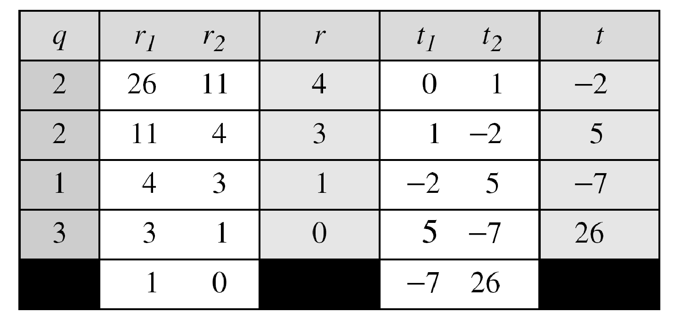
Modular multiplicative inverse
Find the multiplicative inverse of 11 in Z₂₆.
The gcd (26, 11) is 1; the inverse of 11 is −7 or 19.
11x19 mod 26 =1

Slide 55
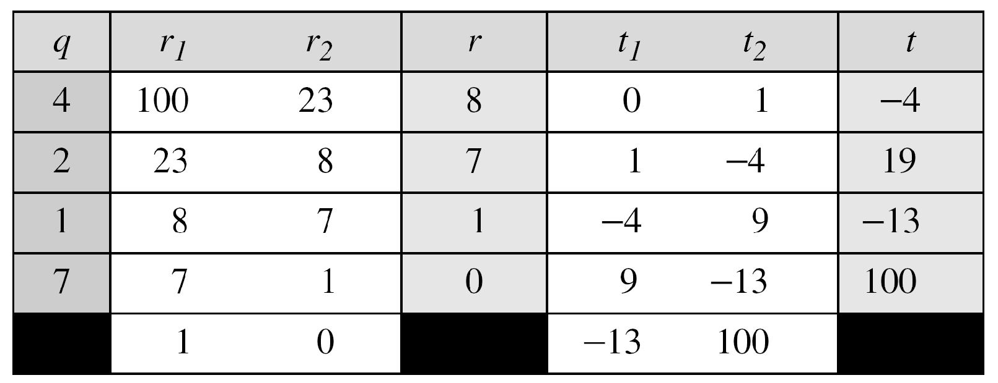
Find the multiplicative inverse of 23 in Z₁₀₀.
The gcd (100, 23) is 1; the inverse of 23 is −13 or 87.

Slide 56
RSA
The most common public-key algorithm is the RSA cryptosystem, named for its inventors (Rivest, Shamir, and Adleman).
To generate the RSA public and private key pair-----🡪
Choose 2 large prime nos. p and q.
Form the product n=p.q
Find ф(n)=(p-1).(q-1)
Choose e such that it is relatively prime to ф(n).
Choose d such that : e x d mod ф(n)=1
(Or d is the multiplicative inverse of e in Z _{ф(n)} )

Slide 57

Public Key -- (e,n)
Private Key– d
Encryption and Decryption are accomplished via modular
exponentiation .
If M is the message :
Encryption --🡪
C= Me mod n
Decryption --🡪
M= C^{d} mod n

Slide 58
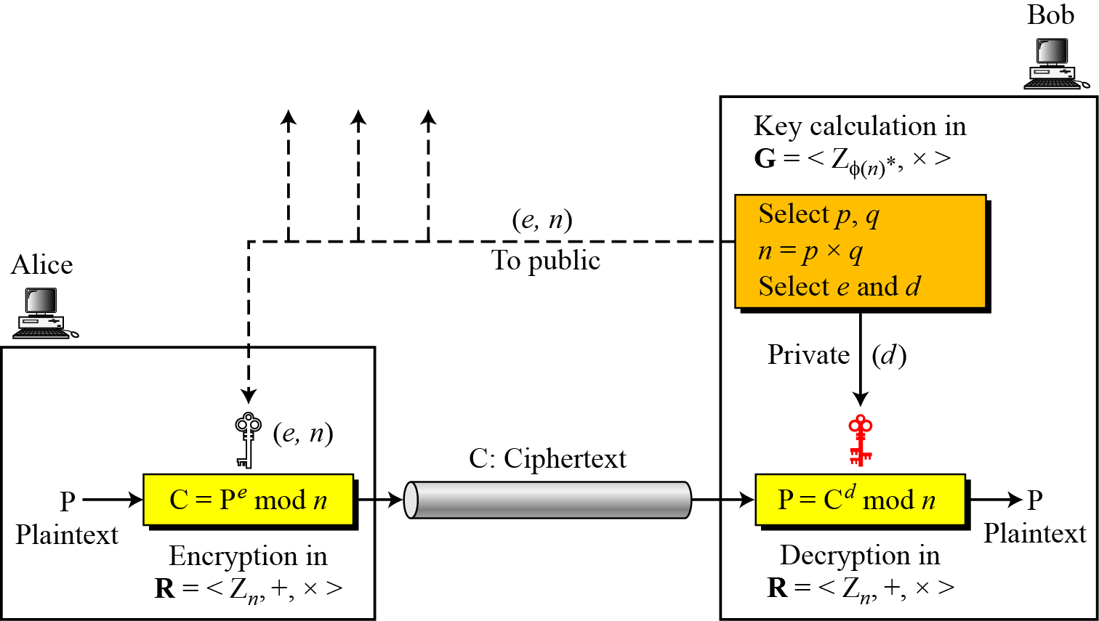

Slide 59
RSA
Example 1
Assume p=11 and q=3
n=11 x 3=33
ф(n)= 10 x 2 = 20
Let e be 3 ( prime to ф(n))
Choose d such that 3d mod 20 =1
To find d there are 2 methods
Extended Euclidean algo to find mod multiplicative inverse
Using
((ф(n)*i) + 1)/e should be integer
Let i be 1 (20*1 + 1)/3 = 7
Since integer hence d=7

Slide 60
Public Key-----(3,33)
Private Key ----- 7
Let M =15
Encryption - C= 15³ mod 33 = 9
Decryption – M= 9⁷ mod 33=15

Slide 61
RSA
To make RSA secure recommended size of p and q is 512 bits(154 decimal digits).
This makes n 1024 bits.

Slide 62
RSA
Example 2
Let p=17 q=11
n=17 x 11 =187
ф(n)=16 x 10 =160
Let e=7
7d mod 160 =1
Method 2 :
((ф(n)*i) + 1)/e should be integer
Let i be 1 (160*1 + 1)/7 = 23
Hence
d=23

Slide 63
Let M=88
Encryption ---🡪
C=88⁷ mod 187
=[(88⁴ mod 187) x (88² mod 187) x (88 mod 187)] mod 187
88 mod 187 = 88
88² mod 187 = 7744 mod 187 = 77
88⁴ mod 187 = [(88² mod 187) x (88² mod 187) ] mod 187 =132
C= (132 x 77 x 88) mod 187 =894,432 mod 187 = 11
In the preceding example shows, we can make use of a property of modular arithmetic:
[(a mod n) * (b mod n)] mod n = (a * b) mod n

Slide 64
RSA
Decryption --🡪
M= 11²³ mod 187
11²³ mod 187 =[(11¹ mod 187) x (11² mod 187) x (11⁴ mod 187)
x 11⁸ mod 187 x 11⁸ mod 187 ) ] mod 187
11¹ mod 187=11
11² mod 187 =121
11⁴ mod 187 = 14641 mod 187 =55
11⁸ mod 187 = 33
11²³ mod 187 = [(11 x 121 x 55 x 33 x 33)] mod 187 = 88

Slide 65
RSA
Step 1. Choose two primes p and q.
Example: p = 5 and q = 13.
Step 2. Let n = pq.
n = 5×13 = 65. Step 3.
Let ф(n) = (p −1)(q −1). Example: ф(n) = 4×12 = 48.
Choose E = 11.
((ф(n)*i) + 1)/e should be integer
Let i be 1 (48*1 + 1)/11 = 4.45
Let i be 2 (48*2 + 1)/11 = 8.81
Let i be 3 (48*3 + 1)/11 = 13.18
Let i be 4 (48*4 + 1)/11 = 17.54
Let i be 5 (48*5+ 1)/11 = 21.90
Let i be 6 (48*6 + 1)/11 = 26.27
Let i be 7 (48*7 + 1)/11 = 30.63
Let i be 8 (48*8+ 1)/11 = 35
Hence d = 35.

Slide 66
For example, to encrypt 3, we find
3^11 mod 65 =22
22^35 mod 65 =3

